Slide 1

Problem Solving Sheet

Slide 2
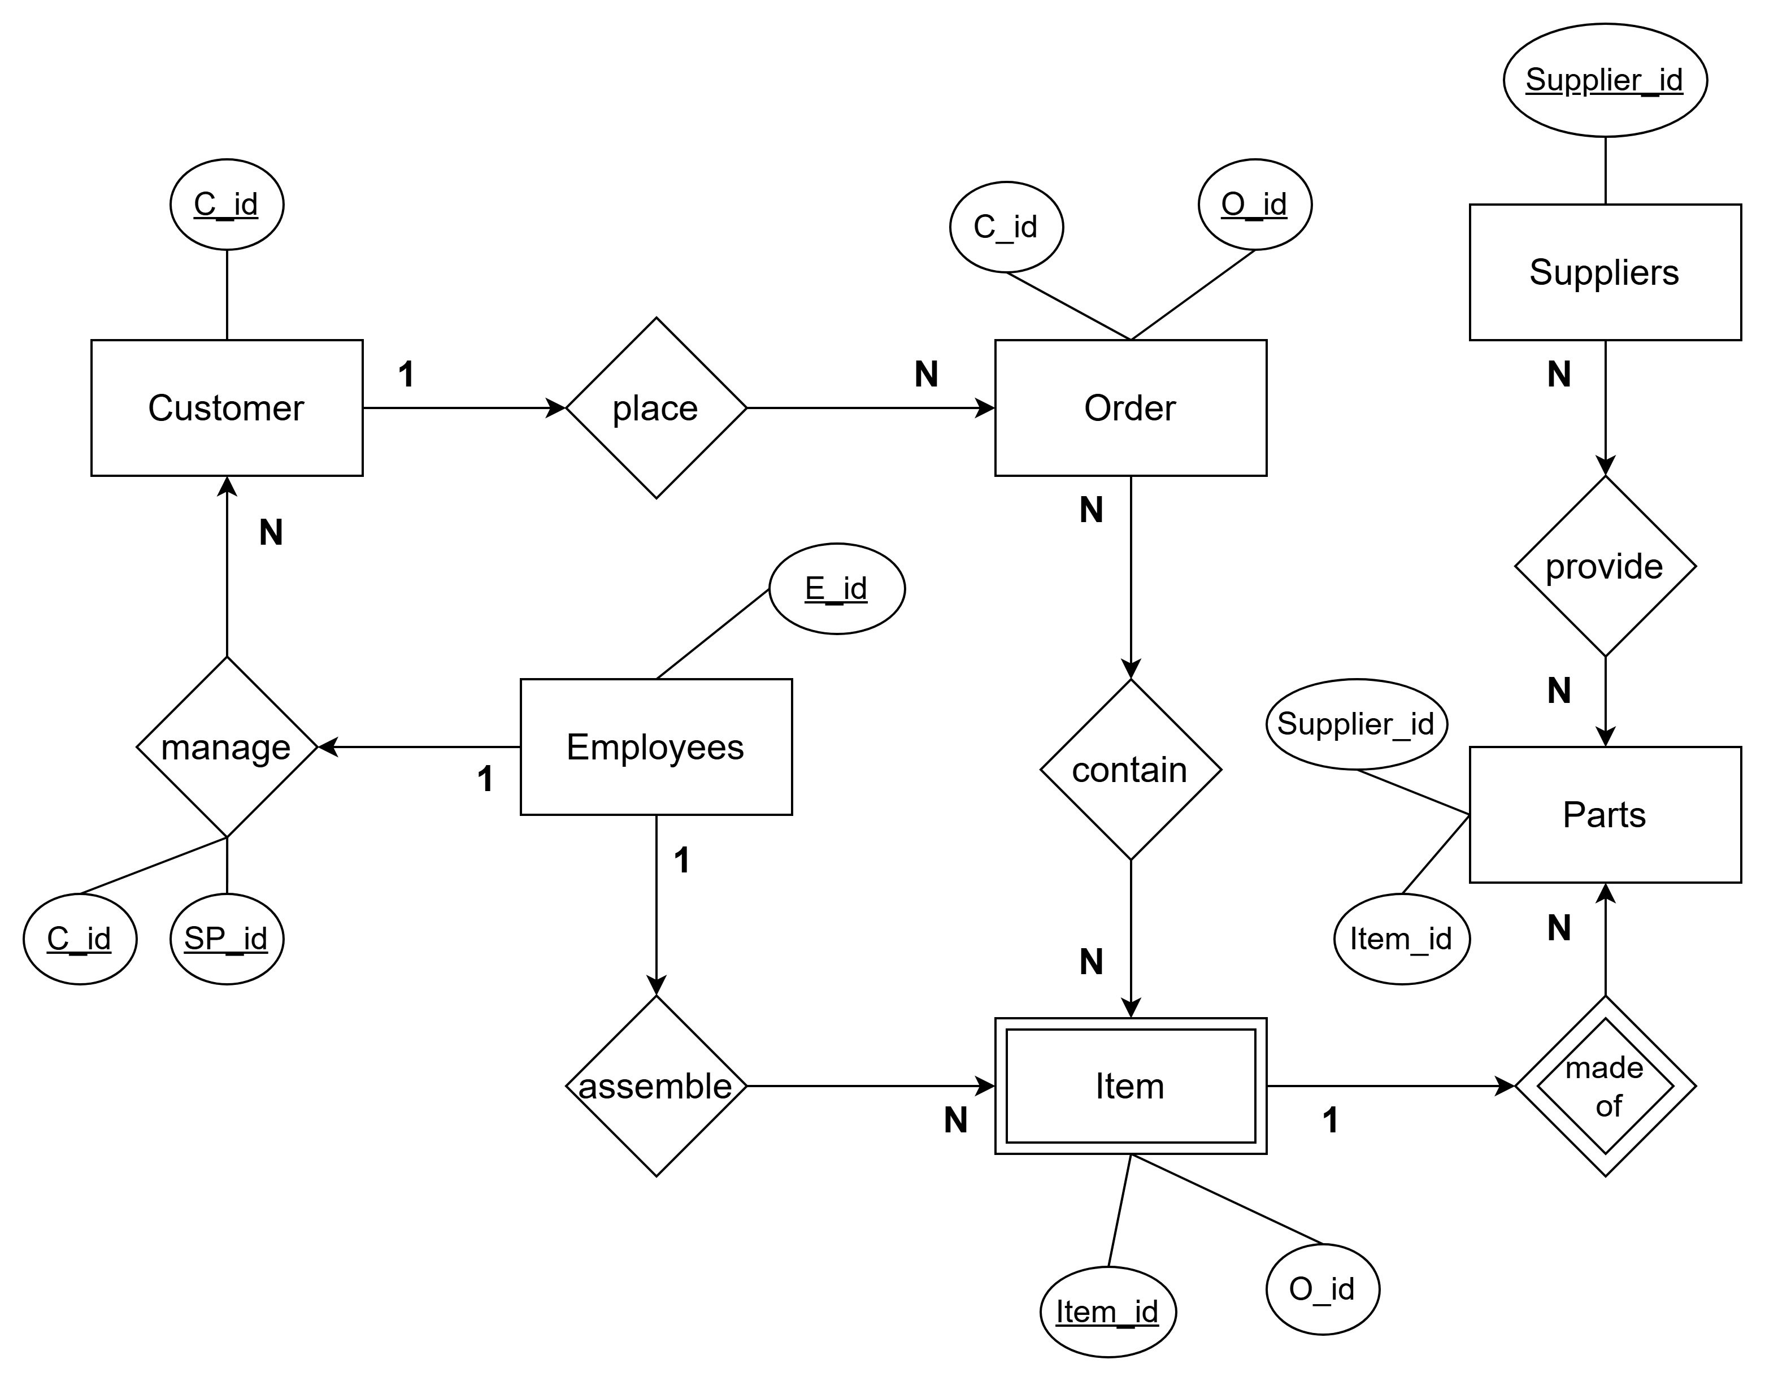
Sales and Inventory Management System

Slide 3
An Employee can be a sales representative
The employee entity doesn’t have foreign key with the item entity, as it is not essential.
Item is a weak entity to the part entity, as if no parts, no item.
List of assumptions:

Slide 4
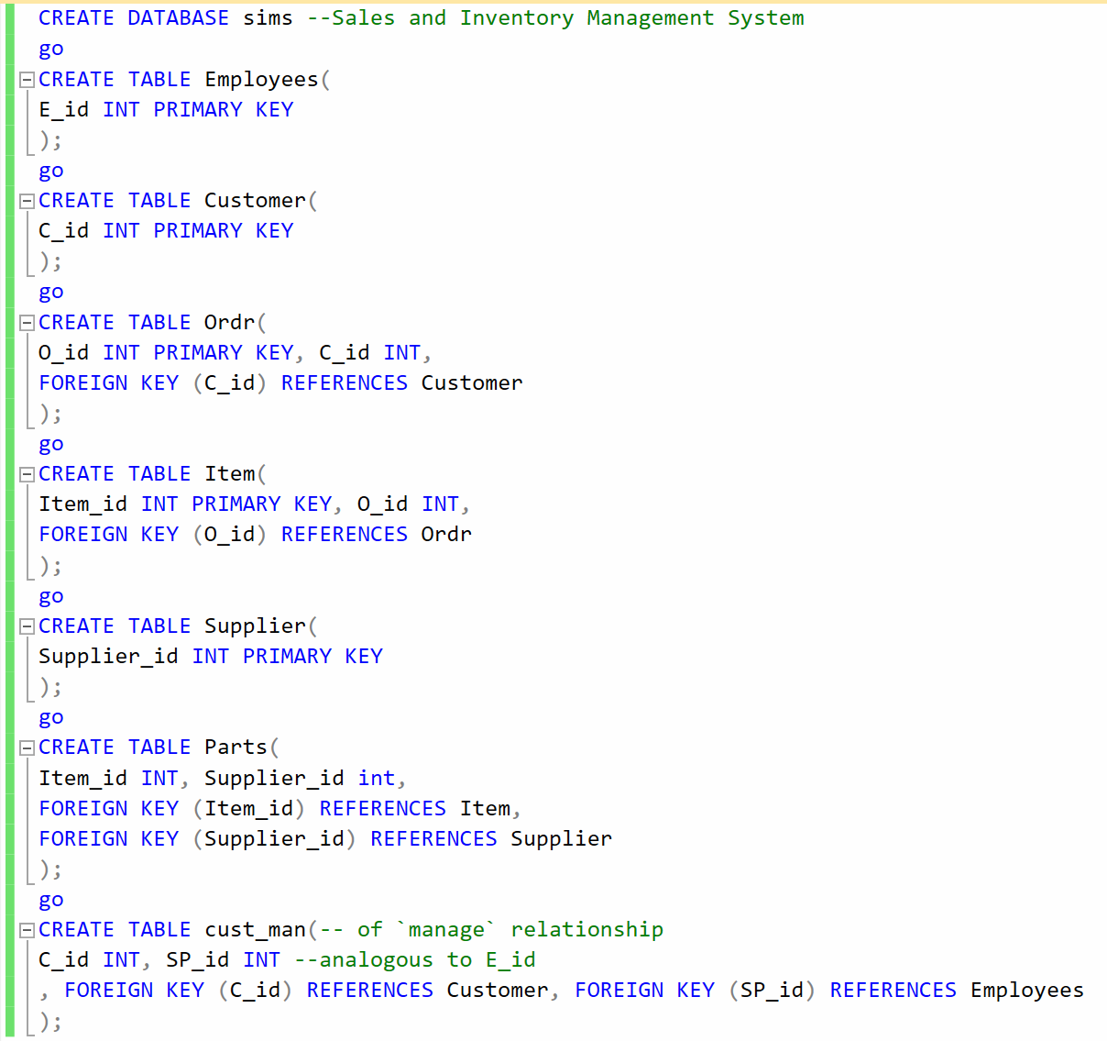
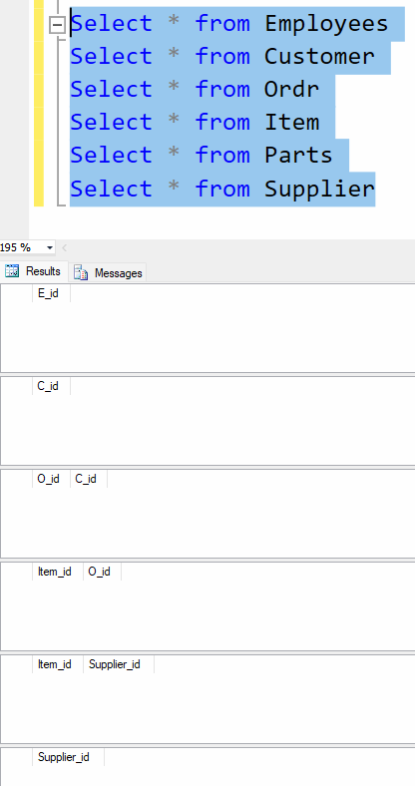
SQL database schema
Note: Ignore `go` lines

Slide 5
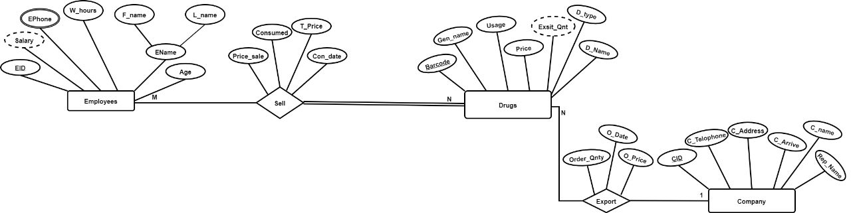
Relationship Rules for ERD A pharmacy database stores details about the drugs and employees who work in the pharmacy that sells the drugs. Keep in mind that the pharmacy has only one main branch.
Dinesh Kumar Bhawnani, BIT DURG

Slide 6
List of assumptions:
The employees in the pharmacy sells some drugs, and each drug has attributes: Barcode (primary key), trade name, generic name, the total number in the pharmacy, the drug usage, type of each drug, and its price.
1
Each employee has an EID (primary key), name (composite: first_ and last_), age, work hours, phone number(multivalued), and salary.
2
The pharmaceutical company has a CID (primary key), address, telephone number, its name indeed, the time to deliver the orders of the drug, and the representative who will be responsible for providing the order.
3
Each order (exportation) must contain the barcode of the required drug, in addition to its quantity, price, and the date of Exportation.
4
Each sell operation must contain the barcode of the required drug, in addition to its quantity and basic price, in addition to its price after applying the 20% discount and the date of the purchase.
5

Slide 7
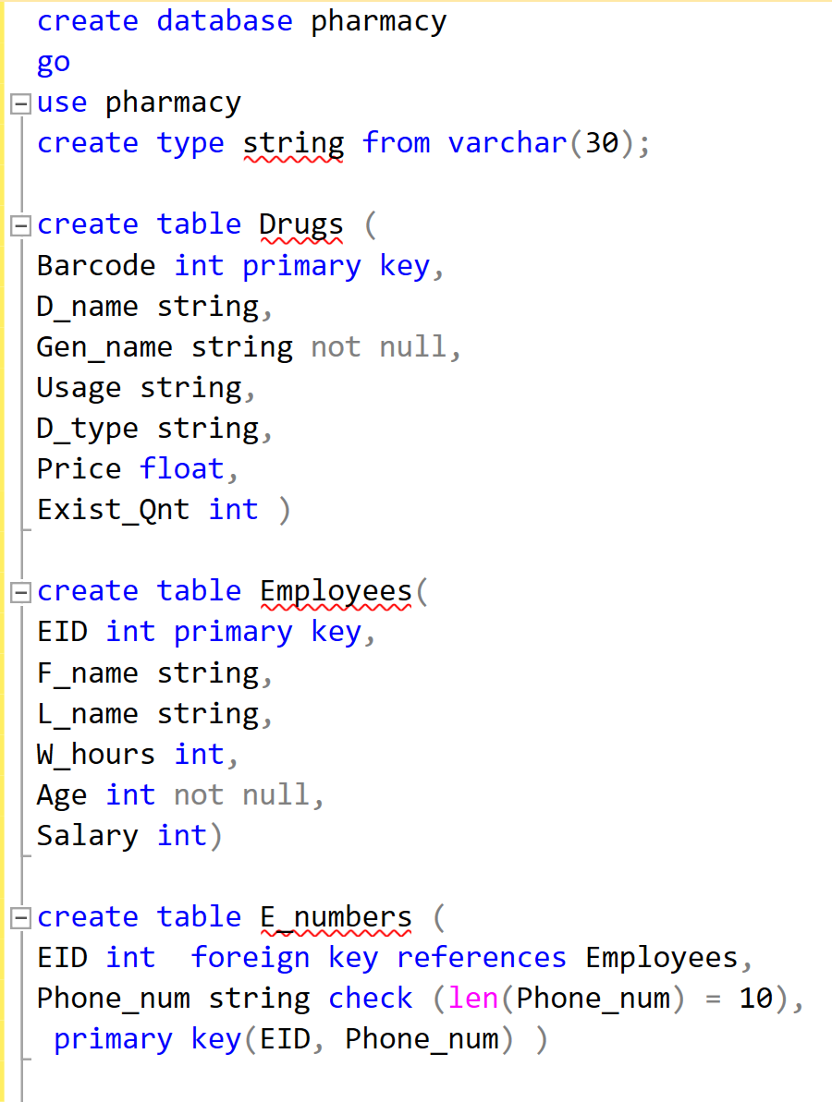
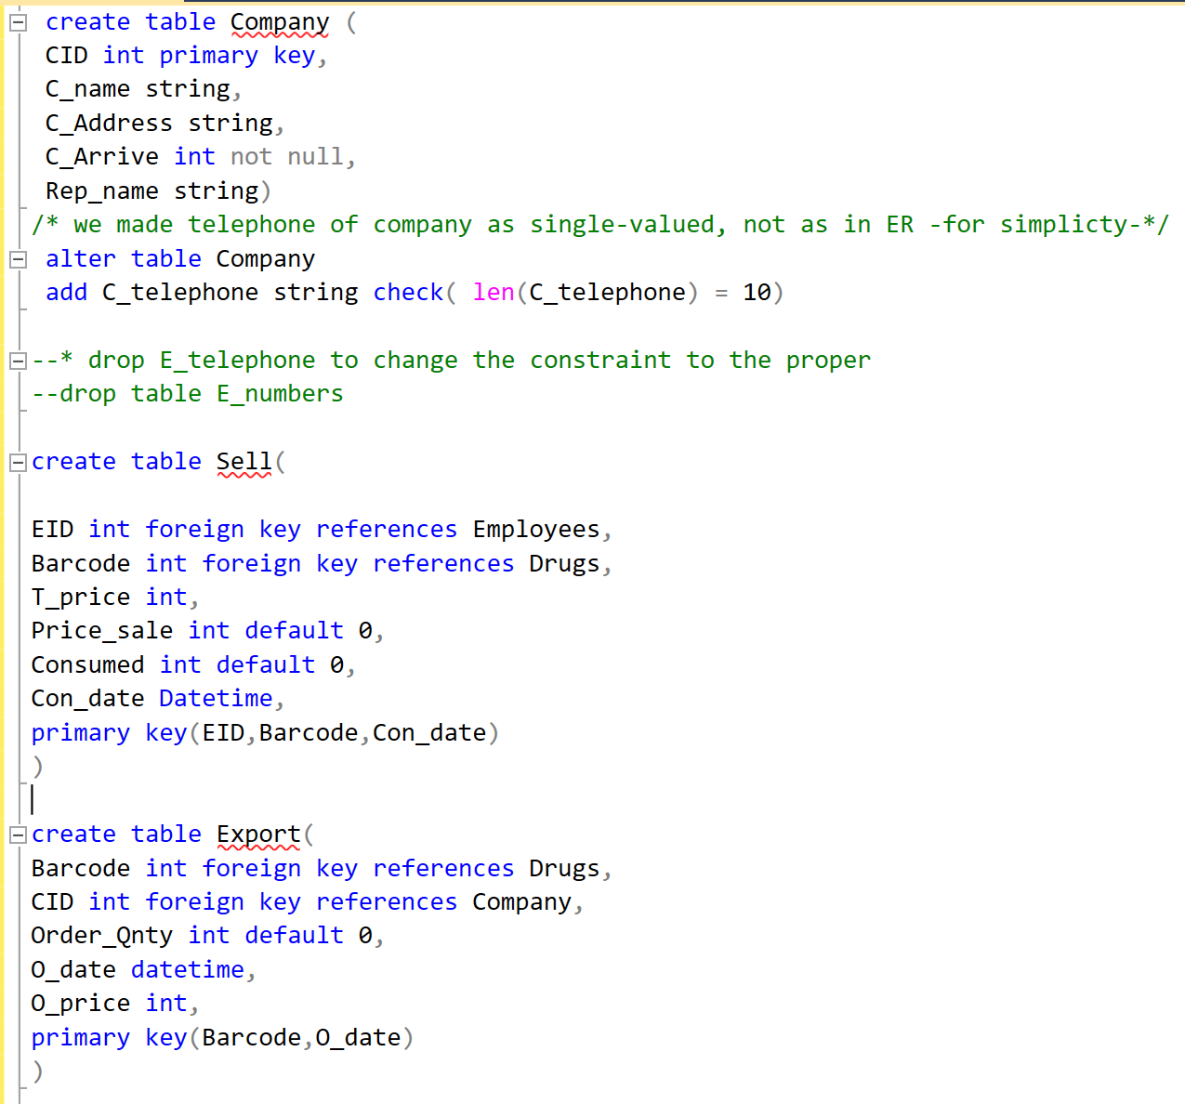
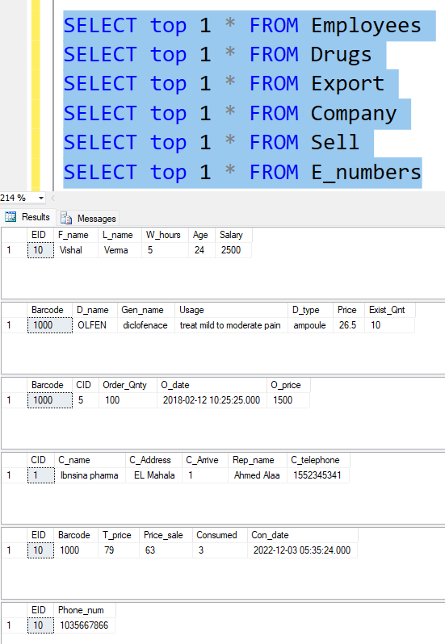
https://github.com/omarnegm2022/Pharmacy-DB
`Watch` its `all activity` ^^

Slide 8
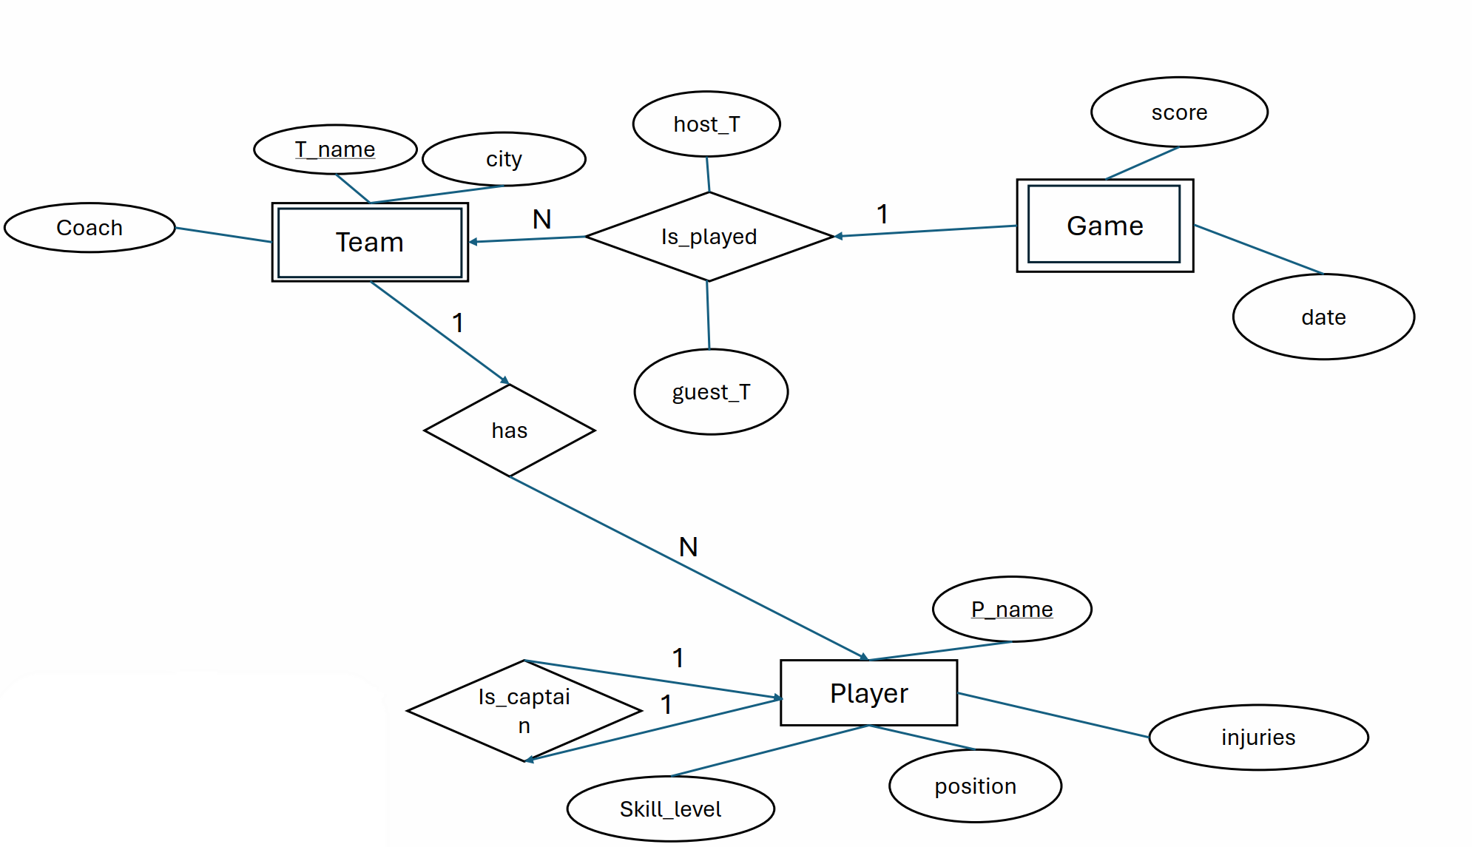
NHL Database Design

Slide 9
List of assumptions:
A Player can be also a team captain
The Game is weak to the team, and in turn:
Team is weak to the player… that’s why
Player is the only strong Entity.

Slide 10
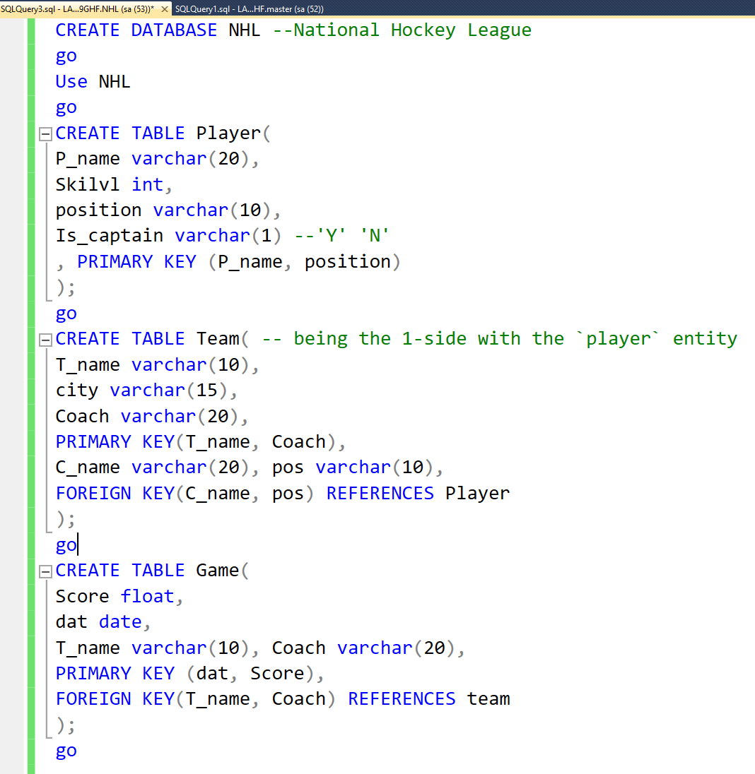
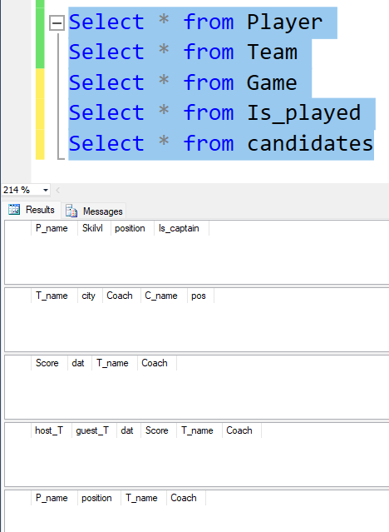
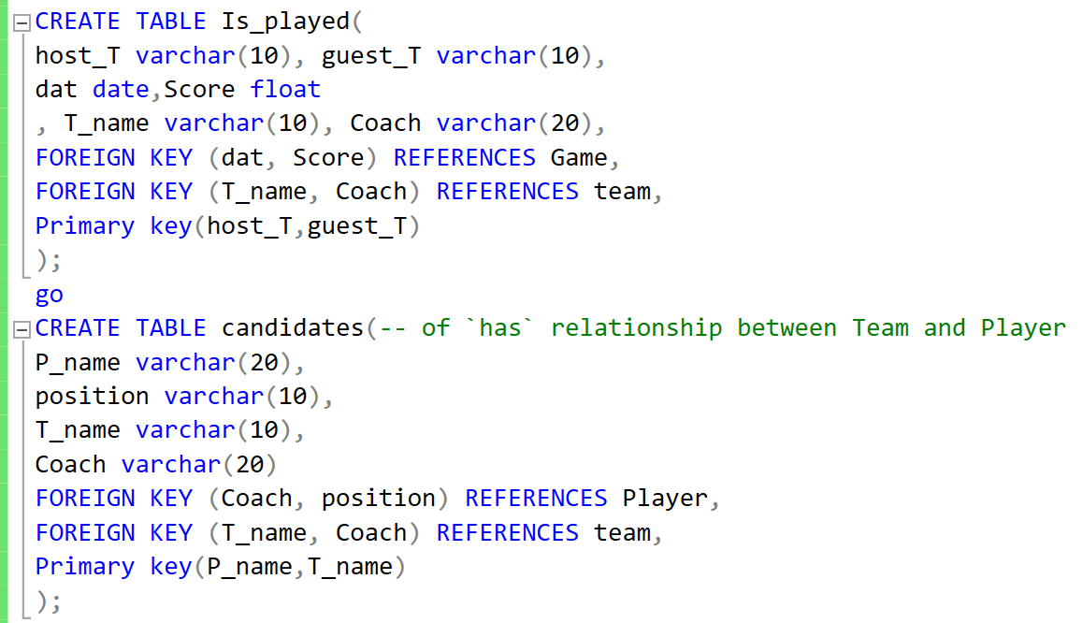
The SQL database schema

